Slide 1

Ad:Check
Big Question One
Activity two: Can advertisers say
whatever they want?

Slide 2
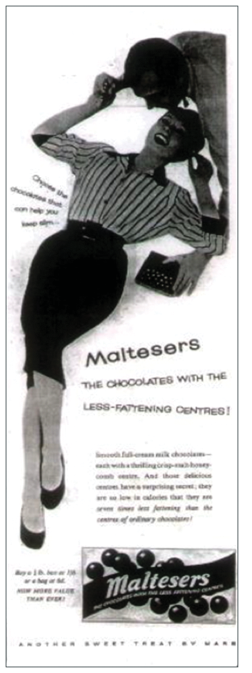
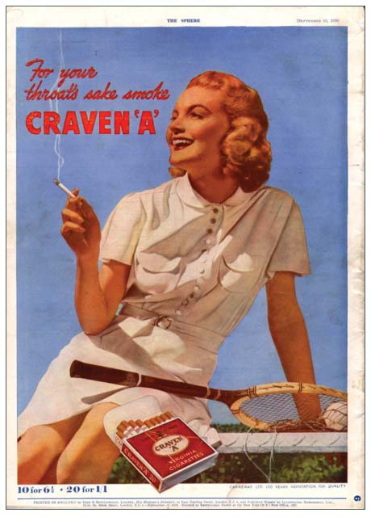
Maltesers 1950s “Choose the chocolates that can help you keep slim...”
What are these advertising?
What claims are being made for the products?
What image are they portraying?
Could companies make the same claims for these
product today?
Why? Why not?
Craven ‘A’, 1930s

Slide 3

Contact us
Advertising Standards Authority
Mid City Place, 71 High Holborn
London WC1V 6QT
Telephone 020 7492 2222
www.asa.org.uk

